Slide 1

In Silico Perturbations using Geneformer
Muhammad Ali | 6-10-2025

Slide 2
Introduction
The goal is to design an in silico perturbation pipeline.
Should be scalable to multiple genes.
Ideally it should capture biological nuances missed by simple perturbation assays.

Slide 3
Pipeline Overview
Generate Embeddings using Geneformer for both the unperturbed and the perturbed datasets
PCA, UMAPs, KNNs, LDA, centroid distance, etc.
Single-cell dataset
Perturb gene(s)
Visualization & analysis
Check if the perturbed dataset has more cells that are predicted to be NP, especially when they were actually ALS to begin with
Train an MLP to predict the class of cells – ALS or NP based on the embeddings.

Slide 4
Task 1
Found 42 disease-specific genes for ALS in the dataset (Nijs & Van Damme, 2024).
Built a simple heatmap to see how these genes correlate with each other.
Built a simple function to perturb any specific gene(s).
Perturbed the dataset at the raw counts level and exported it.

Slide 5
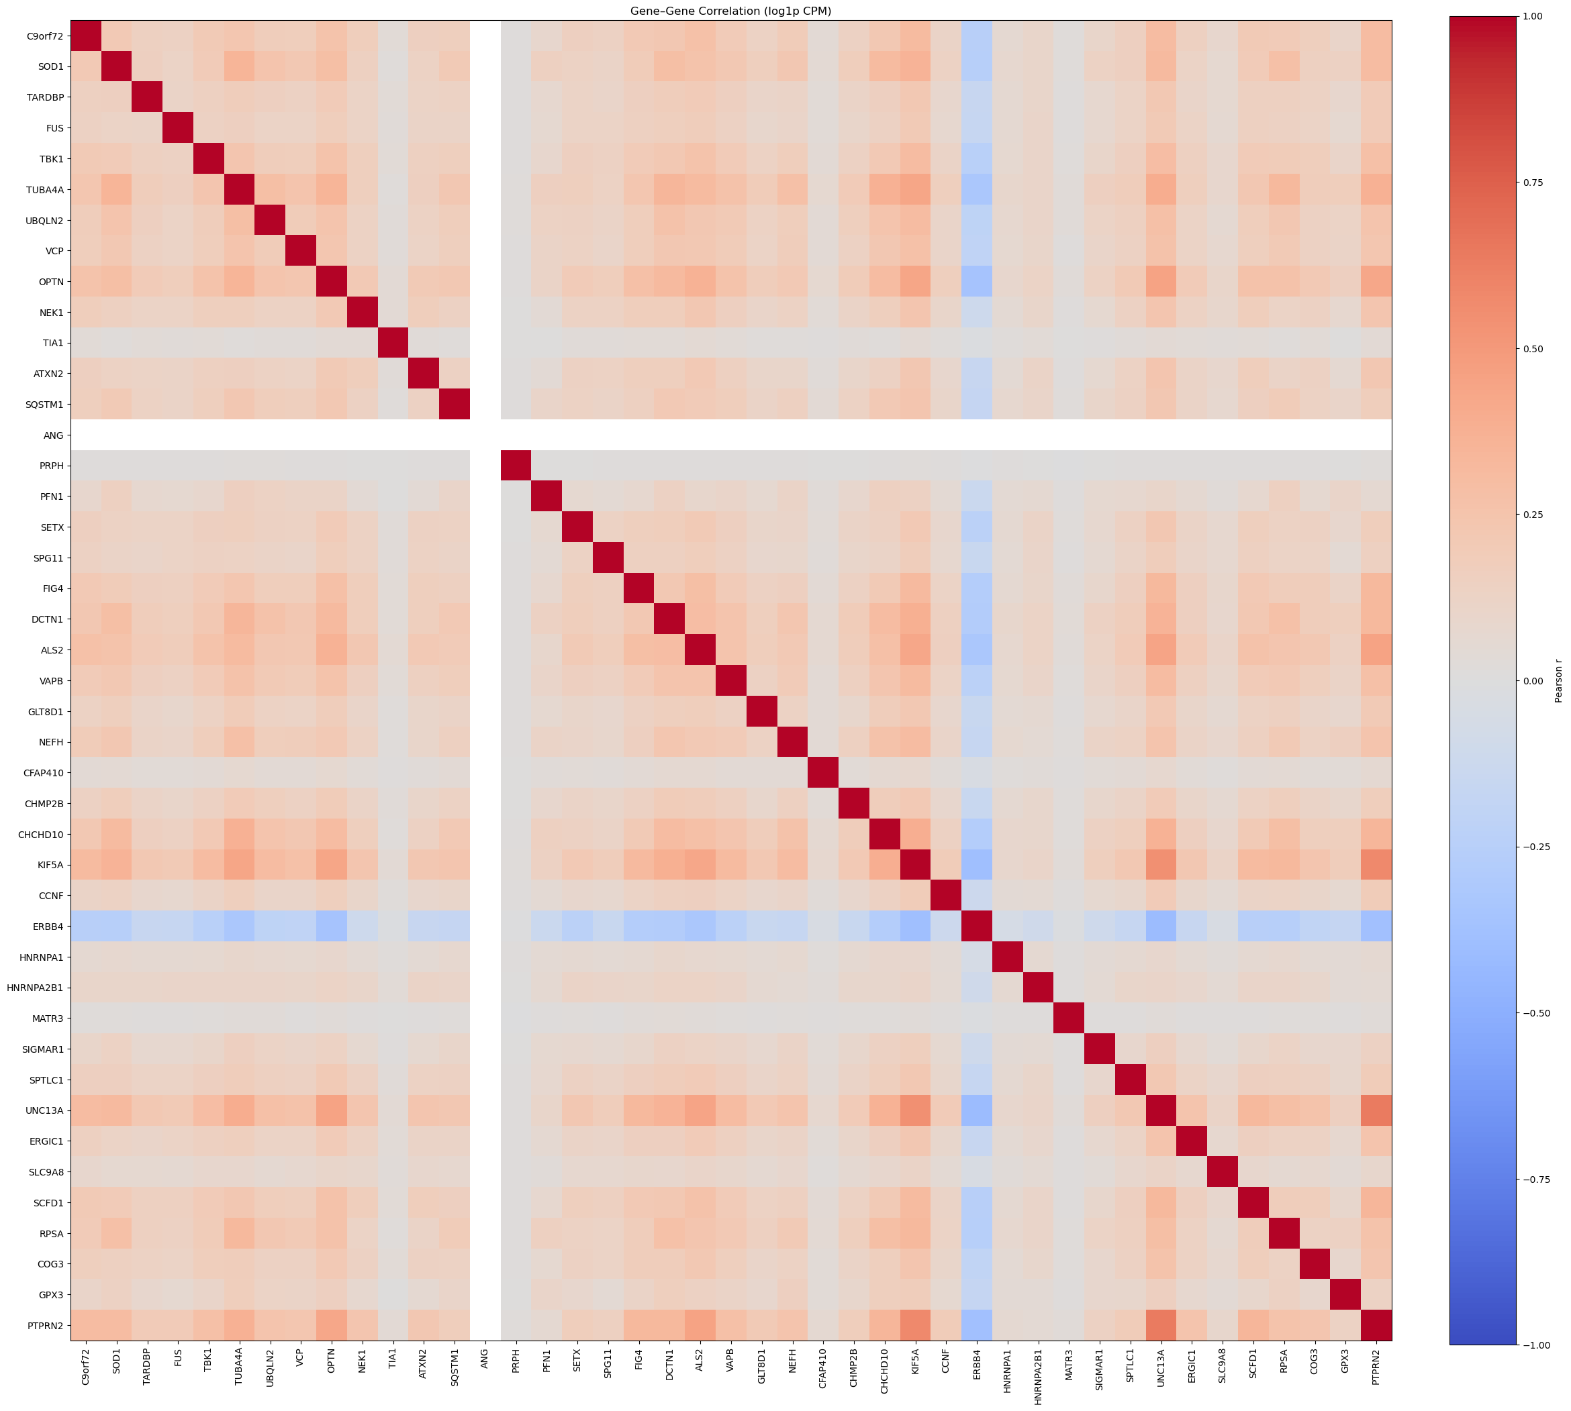
Task 1: Heatmap (Additional)
KIF5A, UNC13A, PTPRN2 – top 3 genes
Top three based on average correlation
Perturbed C9orf72 and KIF5A individually; perturbed top 10 together.

Slide 6
Task 2: Geneformer Embeddings
Simply generated the embeddings by using the Helical API
Took a long time to run - I had to use Kaggle’s GPU because I don’t have access to a GPU.

Slide 7
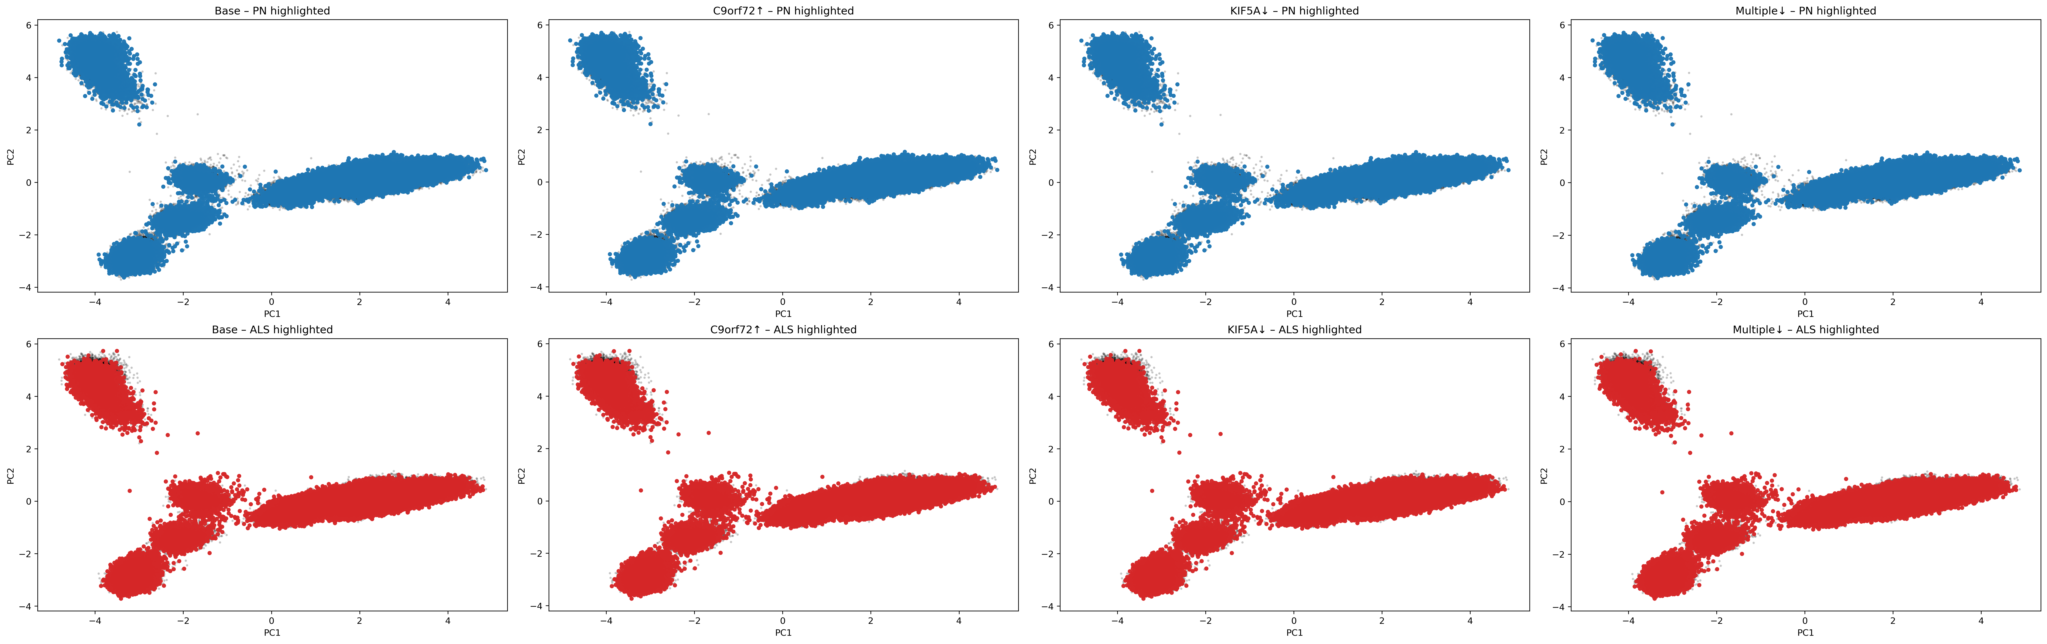
Task 3: PCA

Slide 8
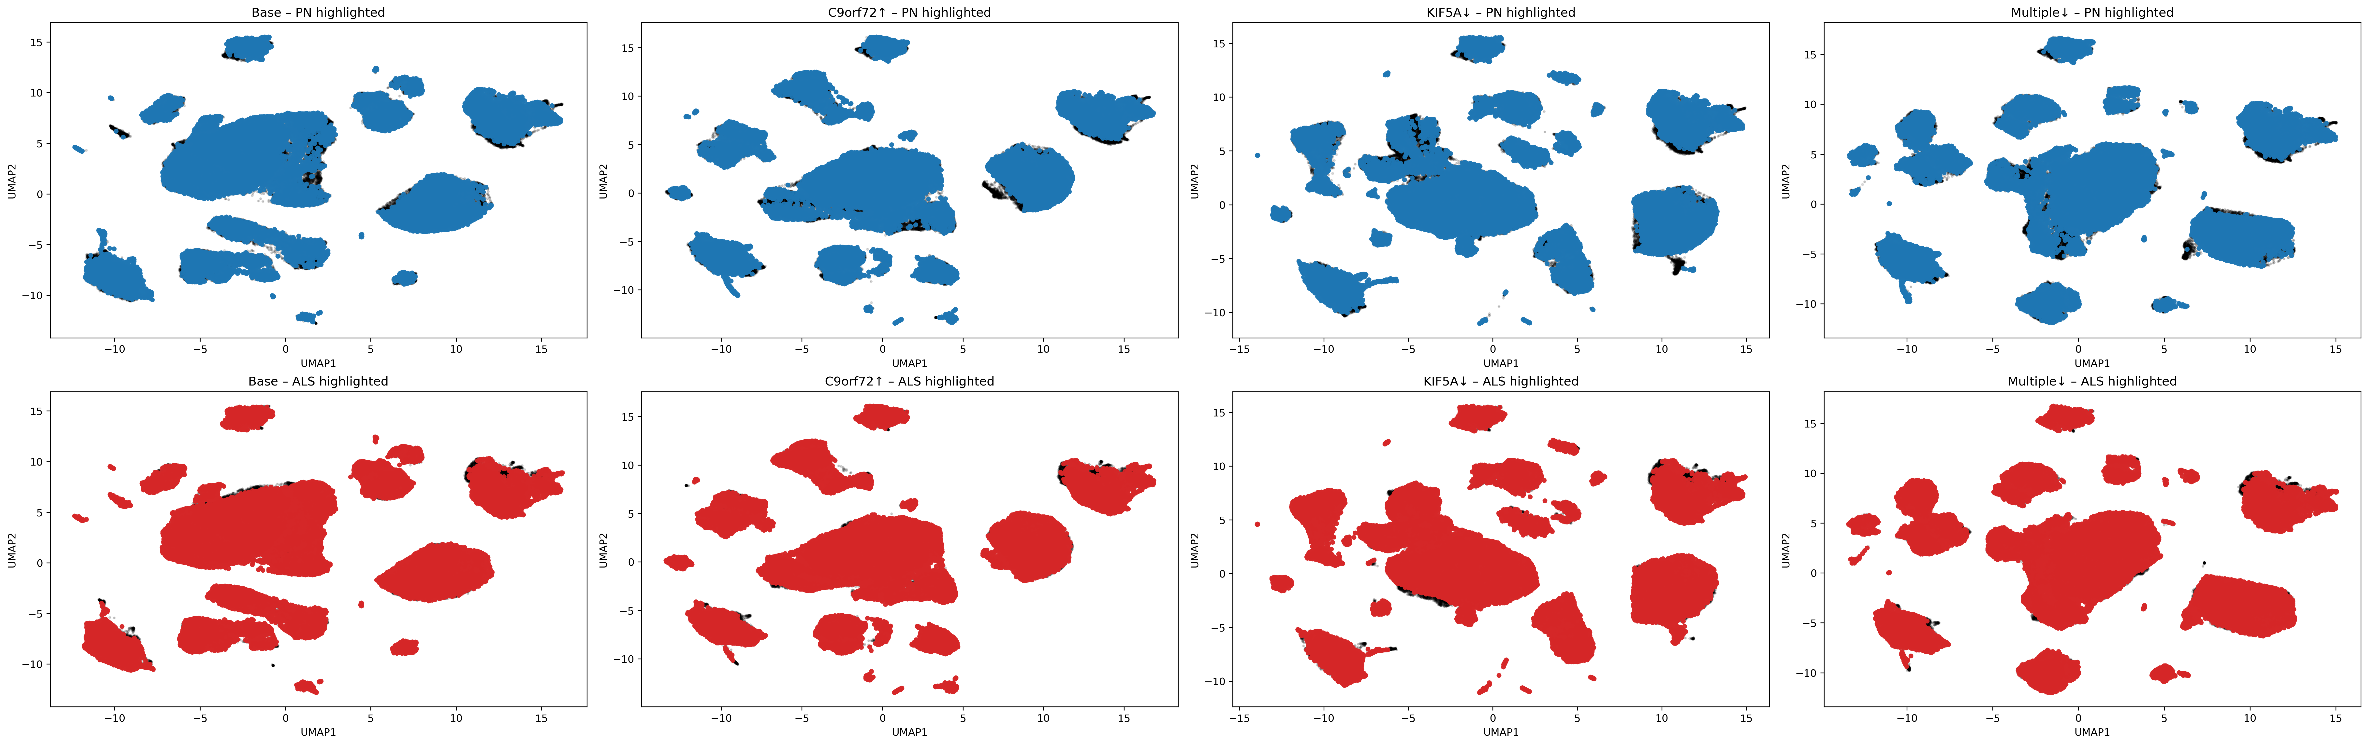
Task 3: UMAP

Slide 9
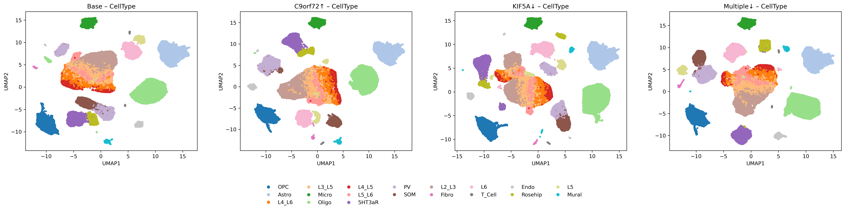
Task 3: UMAP by Cell Types

Slide 10
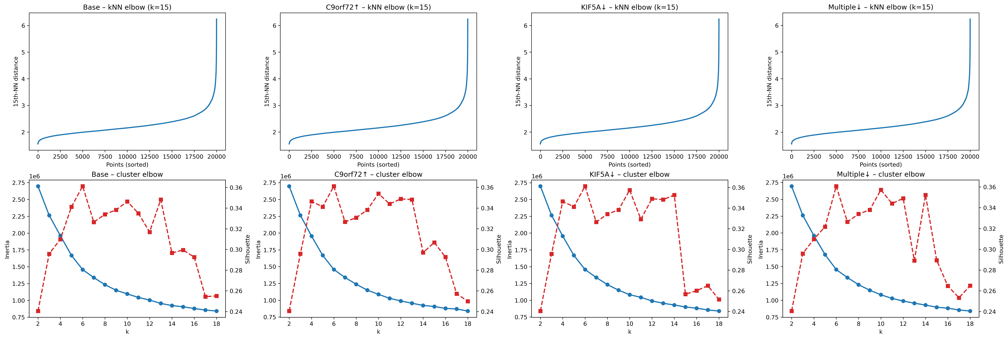
Task 3: Elbow & Silhouette

Slide 11
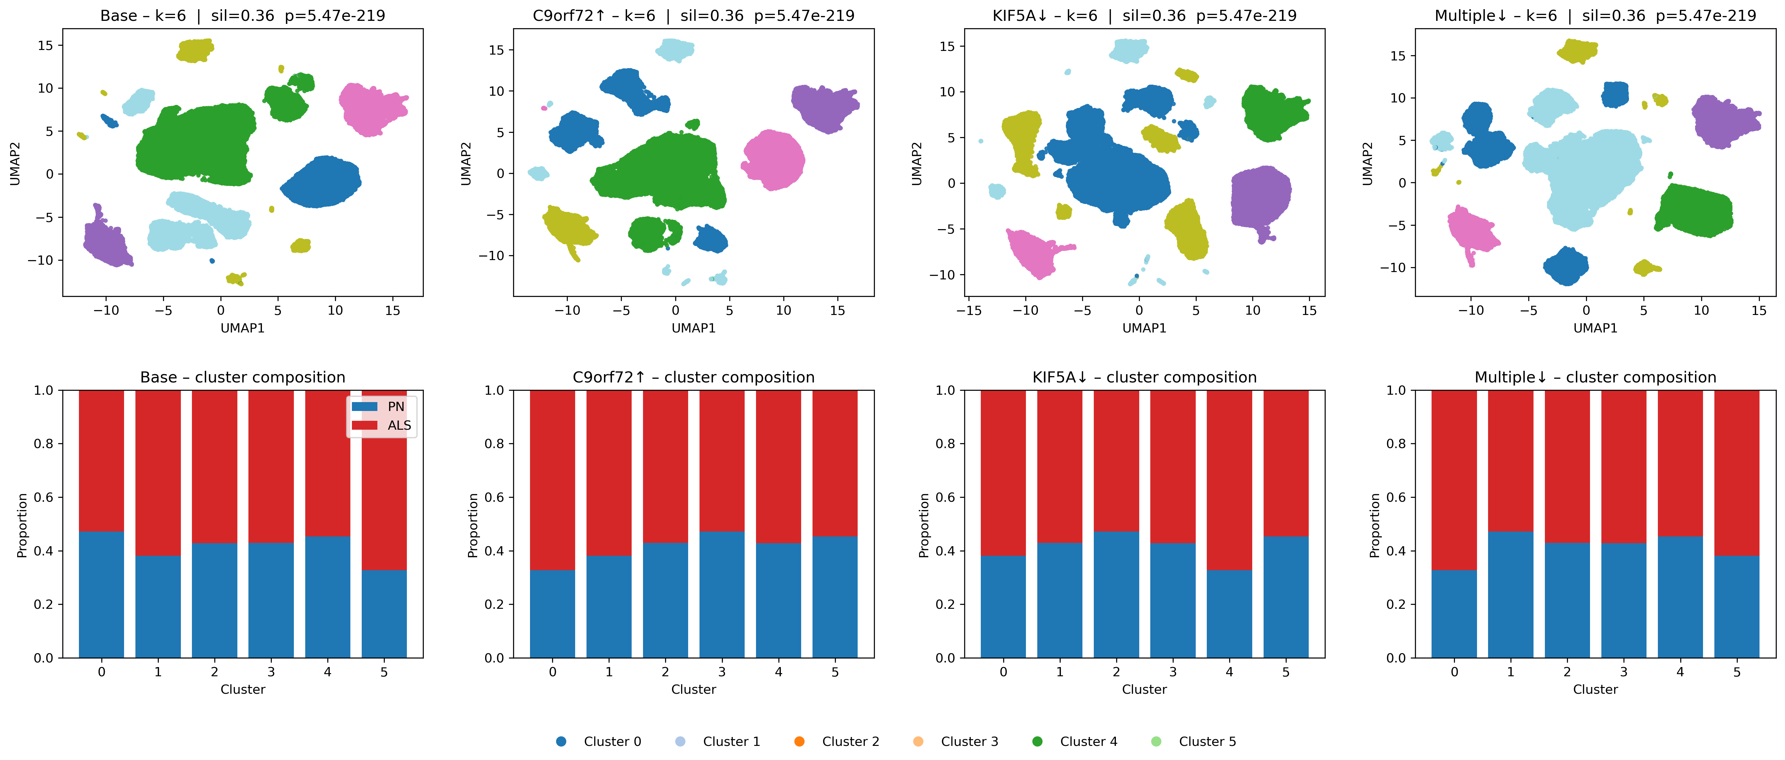
Task 3: kNN Clustering

Slide 12
Task 3 (Add-on): Simple MLP on Embeddings
Simple MLP to predict cell’s condition (ALS or PN)
Trained on embeddings
Applied to the perturbed dataset.
Built using the ‘Split’ column.
Confusion matrices generated only for the ‘test’ cells in the ‘Split’ column.

Slide 13
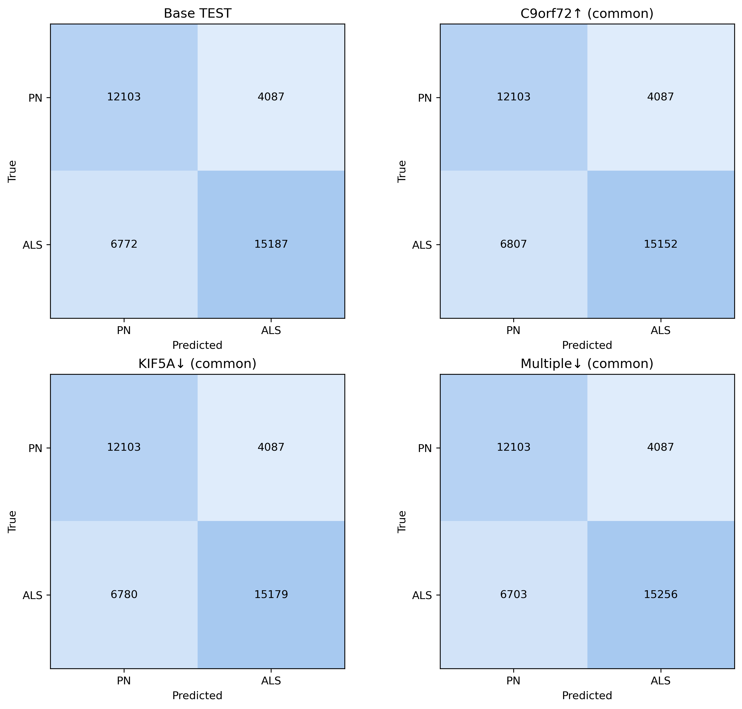
Task 3 (Add-on): Confusion Matrices
AUROC = 0.79
Accuracy = 0.71
Threshold: 0.5
Marginal difference in NP counts.

Slide 14
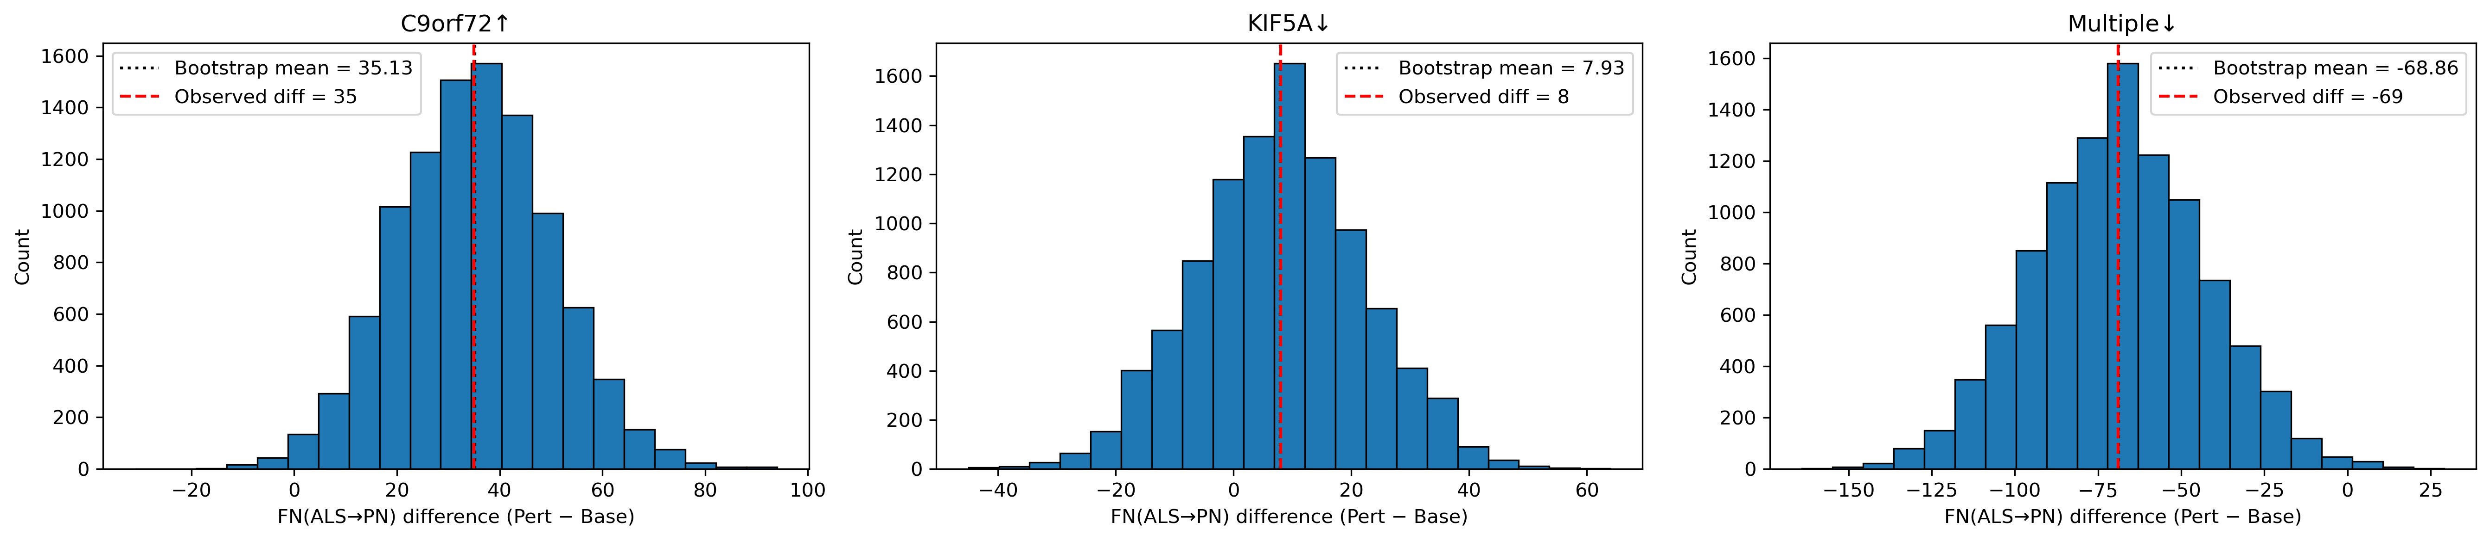
Task 3 (Add-on): Bootstrap for FN Difference
Bootstraps = 10,000 | P-value: > 0.05

Slide 15
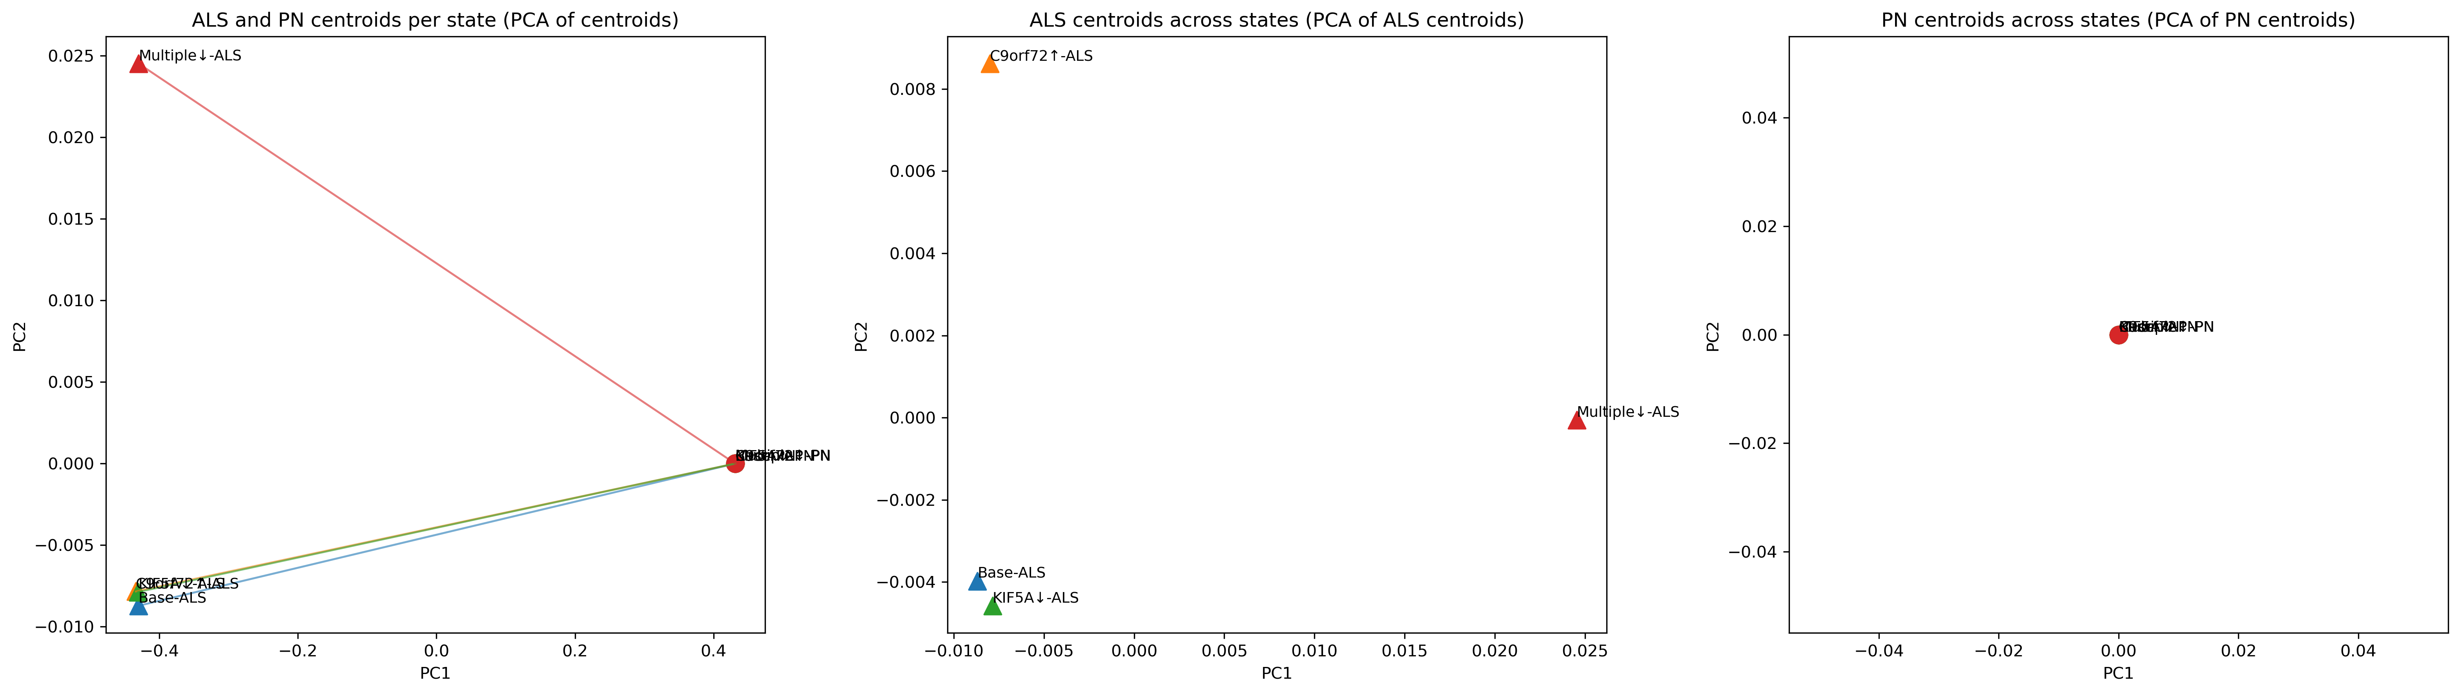
Task 4: Drug Targets
Perturbation | PN-ALS Distance | Change | Alignment
Base | 0.8614 | 0 | 1
C9orf72 | 0.8651 | 0.003593 | 0.999899
KIF5A | 0.8617 | 0.000271 | 0.999989
Multiple | 0.8614 | -0.000055 | 0.999244

Slide 16
Discussions
Lack of compute (GPU – could only run a few perturbations); would really appreciate compute resources (Azure, GCP – whatever works).
Kaggle only allows 12 hours of background jobs – each perturbation took ~4.5 hours
Should build hypotheses by doing some DEG analysis/KEGG to figure out pathways and perturb components.
Ideally want to try the following:
Perturb whole networks of genes that are correlated with each other
Try different permutations of up- and down-regulation

Slide 17
Conclusions
4-fold increase in C9orf72, or decrease in KIF5A and multiple other genes, does not seem to rescue ALS cells significantly.
Perturbing multiple targets seems to have relatively more promising outcomes.
Need more comprehensive analyses with data-driven hypotheses.
Need a lot more GPU resources to effectively test hypotheses.

Slide 18
Thank you for listening!
Happy to answer any questions :)

Slide 19
References
Pineda, S. S., Lee, H., Ulloa-Navas, M. J., Linville, R. M., Garcia, F. J., Galani, K., Engelberg-Cook, E., Castanedes, M. C., Fitzwalter, B. E., Pregent, L. J., Gardashli, M. E., DeTure, M., Vera-Garcia, D. V., Hucke, A. T. S., Oskarsson, B. E., Murray, M. E., Dickson, D. W., Heiman, M., Belzil, V. V., & Kellis, M. (2024). Single-cell dissection of the human motor and prefrontal cortices in ALS and FTLD. Cell, 187(8), 1971–1989.e16. https://doi.org/10.1016/j.cell.2024.02.031
Nijs, M., & Van Damme, P. (2024). The genetics of amyotrophic lateral sclerosis. Current opinion in neurology, 37(5), 560–569. https://doi.org/10.1097/WCO.0000000000001294
Theodoris, C. V., Xiao, L., Chopra, A., Chaffin, M. D., Al Sayed, Z. R., Hill, M. C., Mantineo, H., Brydon, E. M., Zeng, Z., Liu, X. S., & Ellinor, P. T. (2023). Transfer learning enables predictions in network biology. Nature, 618(7965), 616–624. https://doi.org/10.1038/s41586-023-06139-9

